Slide 1

Slides 11-14 to be used for your project pitch. Please send the slides to vismac2025@gmail.com with subject “[ELLIS-VISMAC][Group##] project pitch”. Deadline on Thursday Jan 30th 11:59pm.
Slides 2-10 to be used for the final presentation. You will have 5 mins to present. Please send the slides to vismac2025@gmail.com with subject “[ELLIS- VISMAC][Group##] project presentation”. Deadline Friday Jan 31st 8:59am.
README

Slide 2
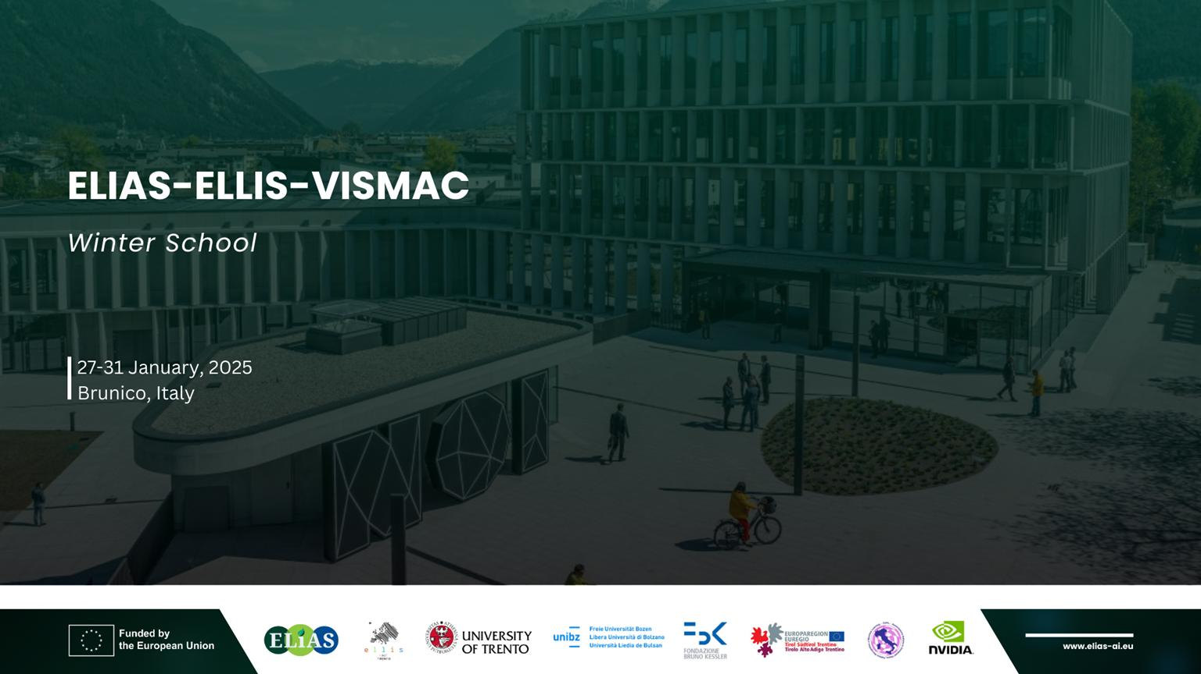

Slide 3
Team Members
Adrián Szlatincsán
Claudio Schiavella
Dania Batool
Francesco Dibitonto
Francesco Pro
B.Y.O.B.
Bring
ruoY
Own
saiB
Team Mentors
Bin Ren
Moreno D’Incà

Slide 4
Problem the team is trying to solve.
Scientific driver for the chosen algorithm.
What’s the algorithmic motif?
What parts are you focused on?
Application
Name

Slide 5
What was your goal?
What was your initial strategy?
How did this strategy change?
Evolution and
Strategy

Slide 6
What were you able to accomplish?
Did you achieve a speed up?
Do you have any GPU numbers
What did you learn?
Did you create a new algorithm?
Did you achieve new scientific goals?
Results

Slide 7
Problems with legacy app structure.
Issues with algorithms.
Tool bugs.
Tool lacking features.
System setup.
What problems have you encountered?

Slide 8
What do you wish existed to make your life easier?
Tools
Language standards
Event
Systems
Wishlist

Slide 9
Was this Project worth it?
Will you continue development?
Next steps, future plans.
What sustained resources or support will be
critical for your work after the event?
Final
Thoughts

Slide 10
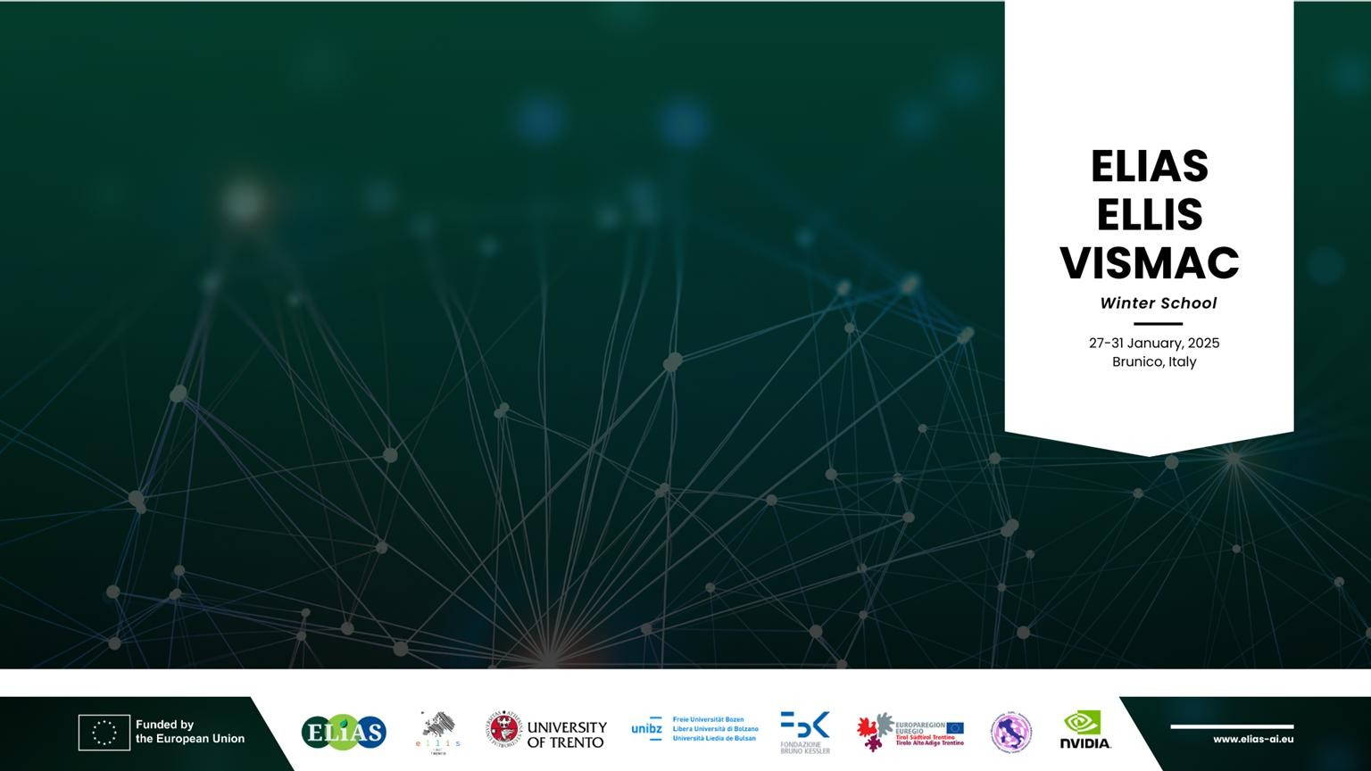
Thank you!

Slide 12
Team Members
Adrián Szlatincsán
Claudio Schiavella
Dania Batool
Francesco Dibitonto
Francesco Pro
B.Y.O.B.
Bring
ruoY
Own
saiB
Team Mentors
Bin Ren
Moreno D’Incà

Slide 13
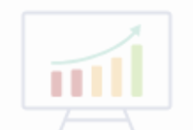
Application Background
Vision Language models (VLMs) have demonstrated remarkable performances
But they have inherited biases from the
training corpus
Target computational motifs: Multimodal Learning, Large-Scale Pretraining, Bias Mitigation
Plot Showing Representative Result
Caption describing figure in simple terms
Hackathon Objectives and Approach
Technical Accomplishments and Impact
Objective:
To mitigate the gender and ethnicity biases in VLMs.
Approach:
Generating an unbiased text-image dataset using GPT4 and FLUX.
Fine-tuning the OpenCLIP model with DoRa using synthetic dataset.
Evaluating the fine-tuned model.
Mitigated the gender and ethnicity biases in OpneCLIP model.
Implemented a fine-tuning approach using synthetic text-image dataset.
This allow a socially-aware use of powerful
VLMs and builds trust in AI systems by improving the fairness and equity.

Slide 14

Project Summary
Please summarize your team’s achievements during the Project (100 words).
In this project, we aimed to mitigate gender and ethnicity biases in Visual Language Models (VLMs). We leveraged GPT-4 for generating captions and explored various text-to-image models. The FLUX model was selected to synthesize images using the captions as prompts and then a dataset of 1,800 images along with unbiased captions was created. In the next step, we studied multiple fine-tuning approaches and selected DoRa for optimal performance. The implementation was carried out on an NVIDIA DGX cluster. Performance. Our approach enhanced fairness in AI-generated imagery through advanced fine-tuning of the OpenCLIP model using unbiased synthetic dataset.

Slide 15
